Slide 1
Grow
Jonathan Haslow-Hall
David Winings
Eugene Raether

Slide 2
Adhesion
(add pictues)

Slide 3
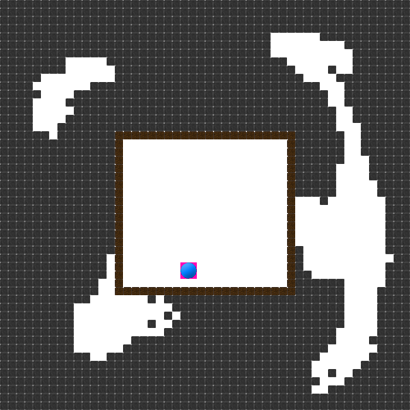
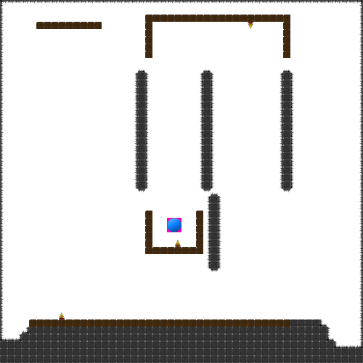
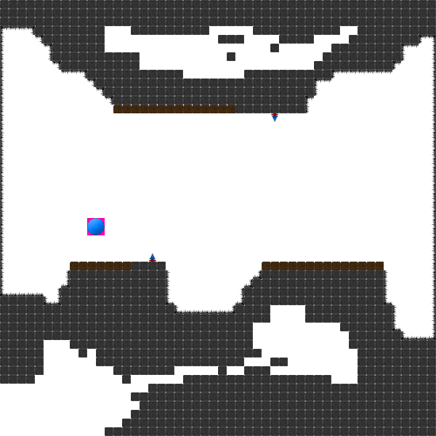
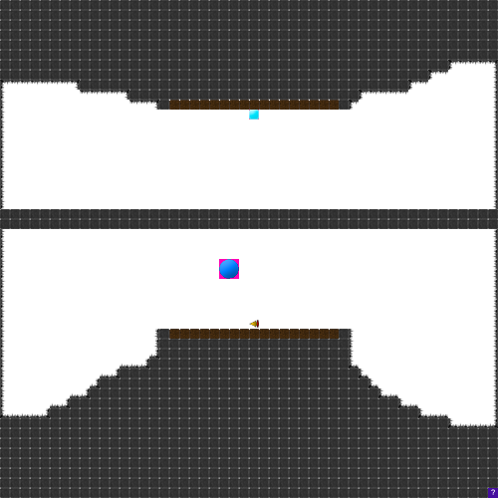
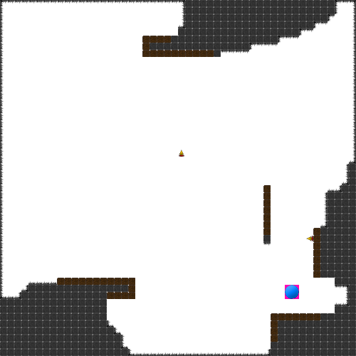
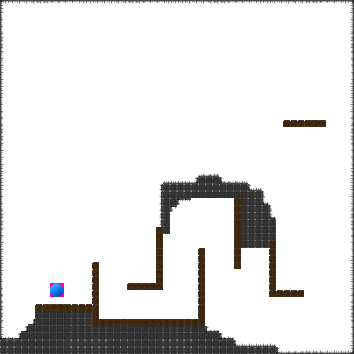
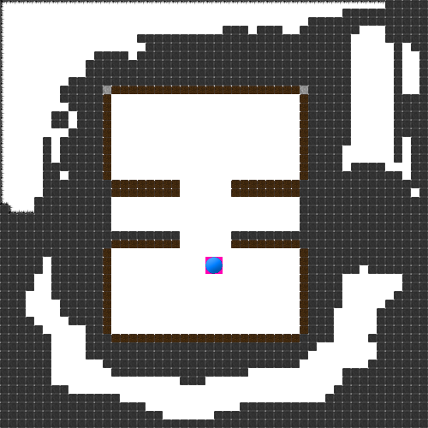
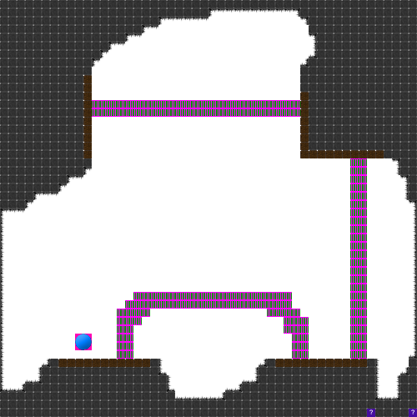
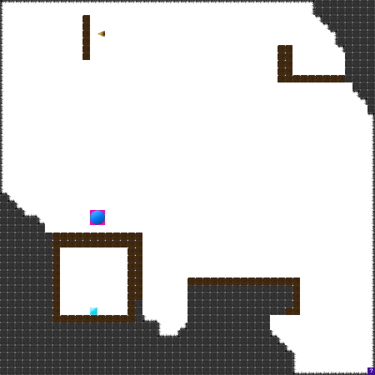
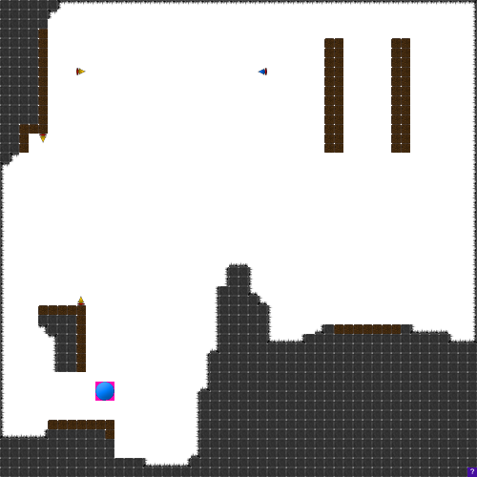
Tons of levels

Slide 4
Live Demo
Run Game

Slide 5
Biggest Challenge
Sounds

Slide 6
Lessons Learned
GitHub is necessary

Slide 7
Next?
More Maps
More blocks
Android

Slide 8
Resources
All done by us.

